Slide 1
ECE 333
Green Electric Energy
Lecture 16: Wind Statistics
Dr. Karl Reinhard
Dept. of Electrical and Computer Engineering
University of Illinois at Urbana-Champaign
reinhrd2@illinois.edu

Slide 2
Announcements
Continue Reading Chapter 7
HW 8 is posted on the website;
Quiz 8 on 5 April
Midterm 2 on 12 April (during class);
  Closed book, closed notes;
  Bring standard calculator
  One 8.5 by 11 inch note sheet that you have prepared

Slide 3
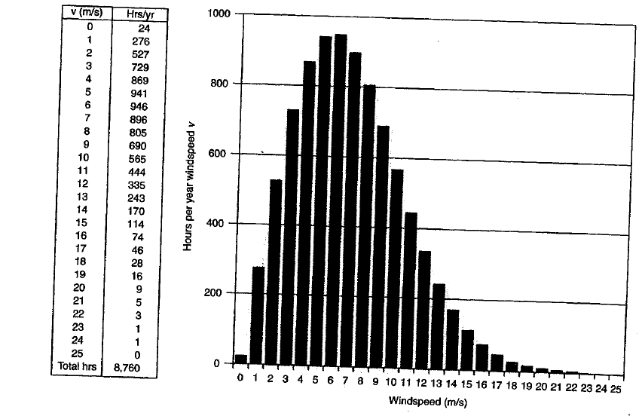
Example Windspeed Site Data

Slide 4
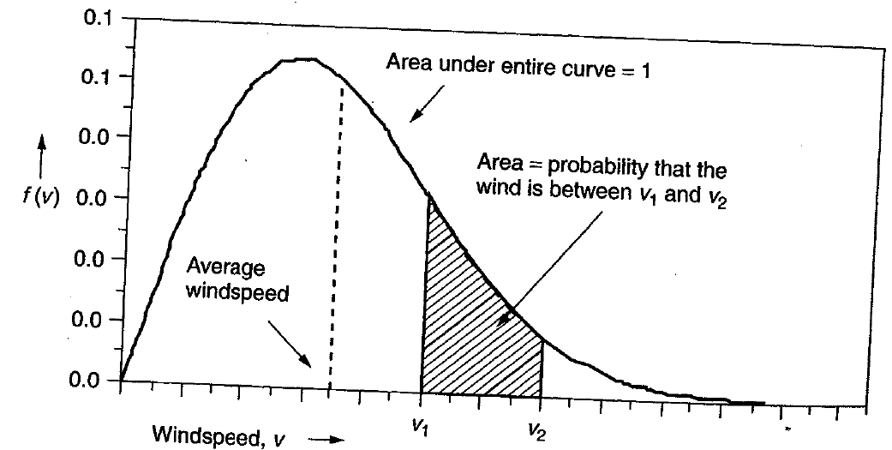
Wind Probability Density Functions
Windspeed probability density function (pdf): between 0 and 1, area under the curve is equal to 1

Slide 5
Windspeed p.d.f.
f(v) = wind speed pdf
Probability that wind is between two wind speeds:
# of hours/year that the wind is between two wind speeds:

Slide 6
Average Windspeed using p.d.f.
This is similar to earlier summation, but now we have a continuous function instead of discrete function
Same for the average of (v³)
discrete
continuous
discrete
continuous

Slide 7
Weibull p.d.f.
Starting point for characterizing statistics of wind speeds
k = shape parameter
c = scale parameter
Keep in mind actual data is key. The idea of introducing the Weibull pdf is to see if we can get a an equation that approximates the characteristics of actual wind site data

Slide 8
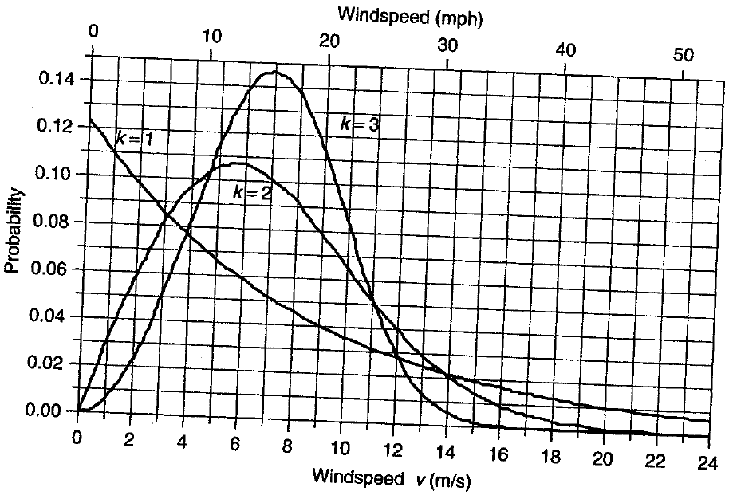
Weibull p.d.f.
k=2 looks reasonable for wind
Weibull p.d.f. for c = 8

Slide 9
Where did the Weibull PDF Come From
Developed by Waloddi Weibull in 1937, and presented in hallmark American paper in 1951
Weibull's claim was that it fit data for a wide range of problems, ranging from strength of steel to the height of adult males
Initially greeted with skepticism – it seemed too good to be true, but further testing has shown its value
Widely used since it allows a complete pdf response to be approximated from a small set of samples
  But this approximation is not going to work well for every data set!!
Reference: http://www.barringer1.com/pdf/Chpt1-5th-edition.pdf

Slide 10
Rayleigh PDF
This is a Weibull pdf with k = 2
Typical starting point when little is known about the wind at a particular site
Fairly realistic for a wind turbine site – winds are mostly pretty strong but there are also some periods of low wind and high wind

Slide 11
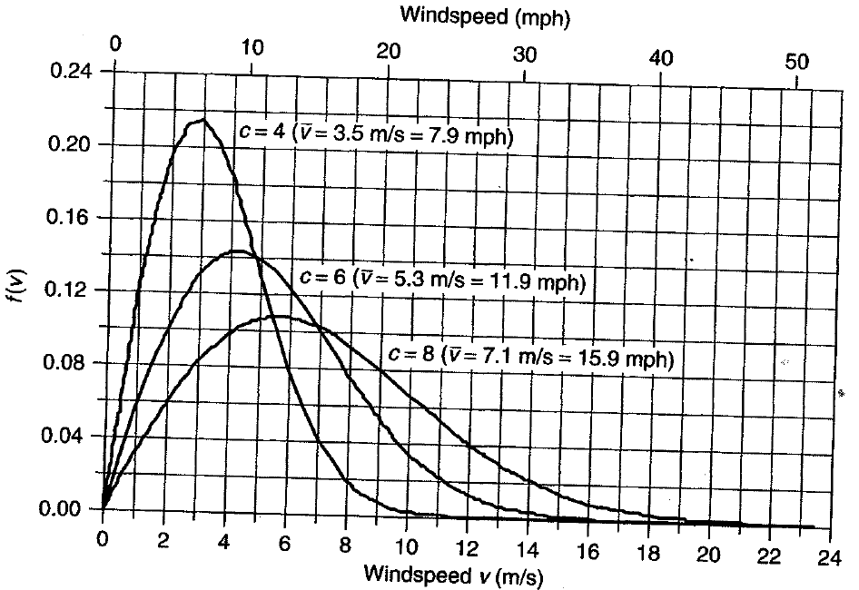
Rayleigh PDF (Weibull with k=2)
Higher c implies higher average wind speeds

Slide 12
Rayleigh PDF
When using a Rayleigh pdf there is a direct relationship between average wind speed v and scale parameter c
Substitute in the Rayleigh pdf :

Slide 13
Rayleigh PDF
From this we can solve for c in terms of v
Then we can substitute this into the Rayleigh pdf for c

Slide 14
Rayleigh Statistics – Average Power in the Wind
Can use Rayleigh statistics when all you know is the average wind speed
Anemometer is used to measure wind
  Spins at a rate proportional to wind speed
  Has a revolution counter that indicates “miles” of wind that pass
  Dividing “miles” of wind by elapsed hours gives the average wind speed (miles/hour)
  “Wind odometer”
  Low cost and easy to use

Slide 15
Rayleigh Statistics – Average Power in the Wind
Assume the wind speed distribution is a Rayleigh distribution
To find average power in the wind, we need (v³)_{avg}
From earlier equations and the Rayleigh pdf:
Then for an assumed Rayleigh pdf we have

Slide 16
Rayleigh Statistics – Average Power in the Wind
This is (v³)_{avg} in terms of c, but we can write c in terms of v_{avg}
Then we have (v³)_{avg} in terms of v_{avg} :

Slide 17
Rayleigh Statistics – Average Power in the Wind
To figure out average power in the wind, we need to know the average value of the cube of velocity:
With Rayleigh assumptions, we can write the (v³)_{avg} in terms of v_{avg} and the expression for average power in the wind is just
This is an important and useful result

Slide 18
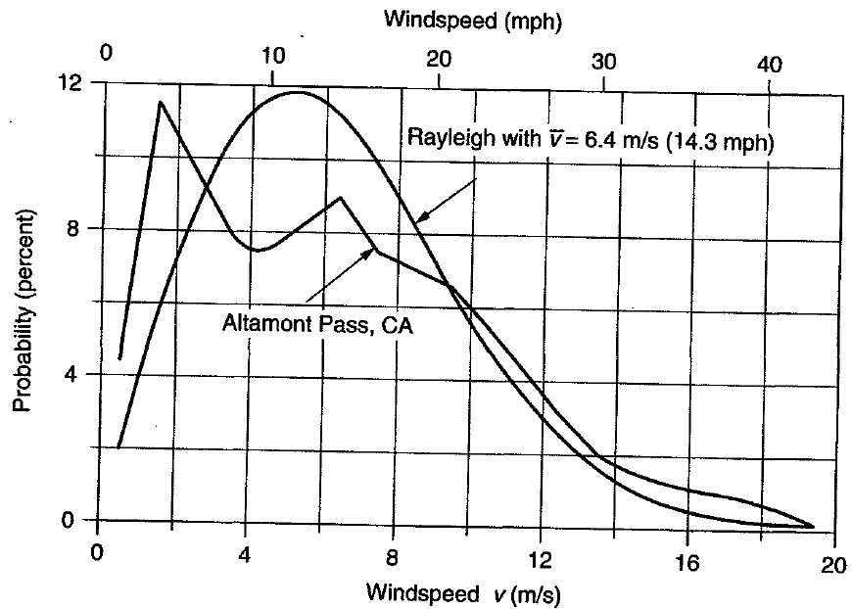
Real Data vs. Rayleigh Statistics
This is why it is important to gather as much real wind data as possible

Slide 19
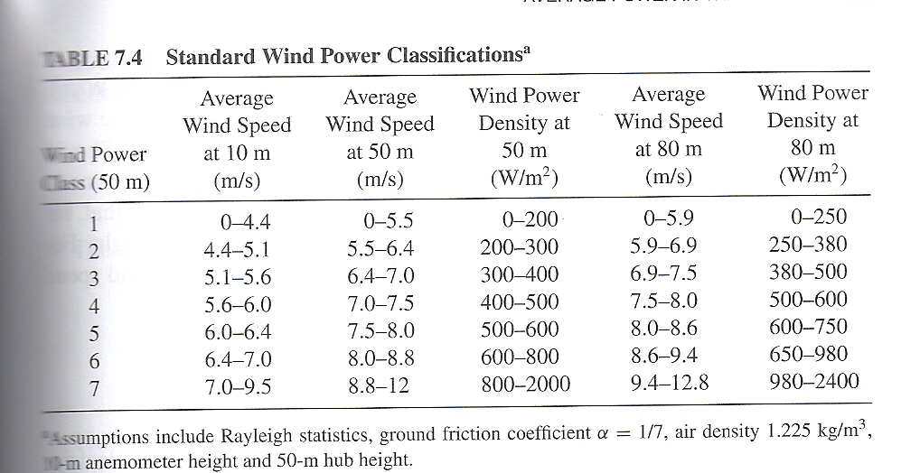
Wind Power Classification Scheme

Slide 20
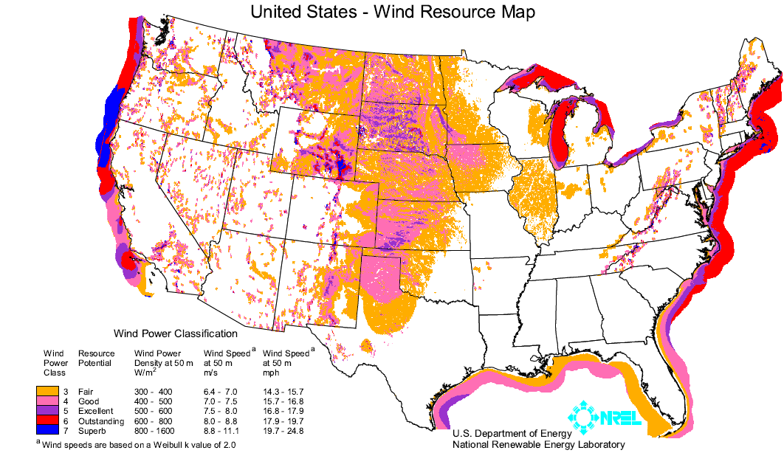
Wind Power Classification Scheme
http://www.windpoweringamerica.gov/pdfs/wind_maps/us_windmap.pdf
Table 6.5

Slide 21
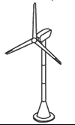
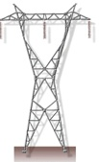
Estimates of Wind Turbine Energy
Not all of the power in the wind is retained - the rotor spills high-speed winds and low-speed winds are too slow to overcome losses
Depends on rotor, gearbox, generator, tower, controls, terrain, and the wind
Overall conversion efficiency (C_{p}·η_{g}) is around 30%
Wind
Power in the Wind
Power to Electricity
Power Extracted by Blades
Rotor
Gearbox & Generator

Slide 22
Wind Farms
Normally, it makes sense to install a large number of wind turbines in a wind farm or a wind park
Benefits
  Able to get the most use out of a good wind site
  Reduced development costs
  Simplified connections to the transmission system
  Centralized access for operations and maintenance
How many turbines should be installed at a site?

Slide 23
Wind Farms
We know that wind slows down as it passes through the blades. Recall the power extracted by the blades:
Extracting power with the blades reduces the available power to downwind machines
What is a sufficient distance between wind turbines so that wind speed has recovered enough before it reaches the next turbine?

Slide 24
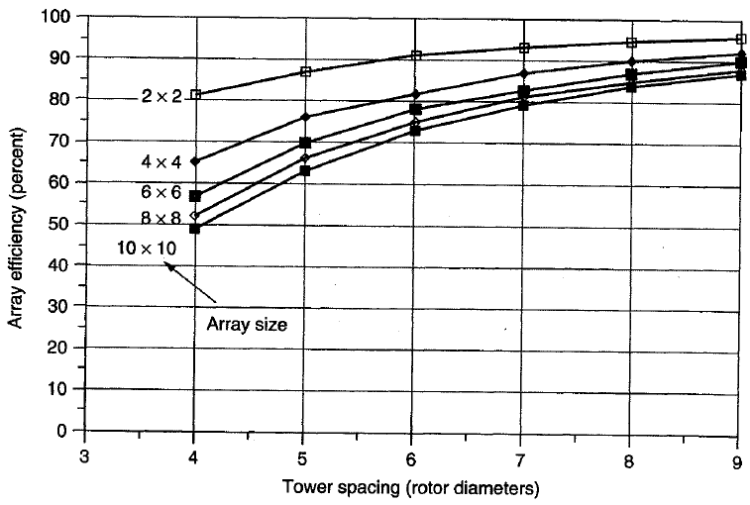
Wind Farms
For closely spaced towers, efficiency of the entire array becomes worse as more wind turbines are added

Slide 25
Wind Farms
The figure considered square arrays, but square arrays don’t make much sense
Rectangular arrays with only a few long rows are better
Recommended spacing is 3-5 rotor diameters between towers in a row and 5-9 diameters between rows
Offsetting or staggering the rows is common
Direction of prevailing wind is common

Slide 26
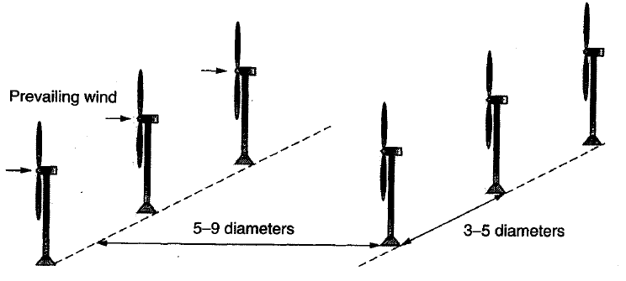
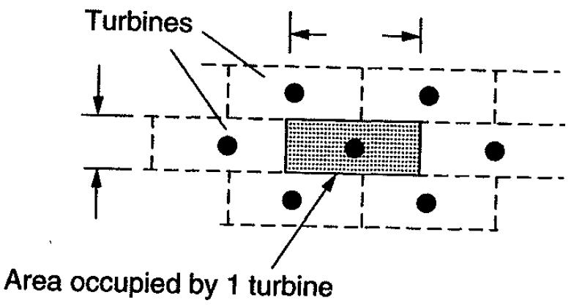
Wind Farms – Optimum Spacing
Ballpark
figure for
GE 1.5 MW in Midwest
is one per
100 acres (6 per square mile)
Optimum spacing is estimated to be 3-5 rotor diameters between towers and 5-9 between rows
5 D to 9D

Slide 27
Example: Energy Potential for a Wind Farm
A wind farm has 4-rotor diameter spacing along its rows, 7-rotor diameter spacing between the rows
WTG efficiency is 30%, Array efficiency is 80%
4D
7D

Slide 28
Example: Energy Potential for a Windfarm
4D
7D
a. Find annual energy production per unit of land area if the power density at hub height is 400-W/m² (assume 50 m, Class 4 winds)
b. What does the lease cost in $/kWh if the land is leased from a rancher at $100 per acre per year?

Slide 29
Example: Energy Potential for a Windfarm
a. For 1 wind turbine:

Slide 30
Example: Energy Potential for a Windfarm
b. 1 acre = 4047m²
In part (a), we found
or equivalently
Then, the lease cost per kWh is

Slide 31
California Ridge Wind Farm Project
Located in NE Champaign and NW Vermilion counties.
Developed by Invenergy with a total capacity of about 217 MW using GE 1.6 MW units (134 turbines total with 30 in Champaign County)
  Hub height of about 100 m, rotor diameter 82.5 m
Project went into service in late 2012
Power is purchased by TVA under long-term contract
Source: http://www.co.vermilion.il.us/ctybrd/Vermilion%20County%20-%20California%20Ridge%20wind%20project%20building%20permit%20application.pdf
Power Purchase Source: http://www.tva.com/power/wind_purchases.htm

Slide 32
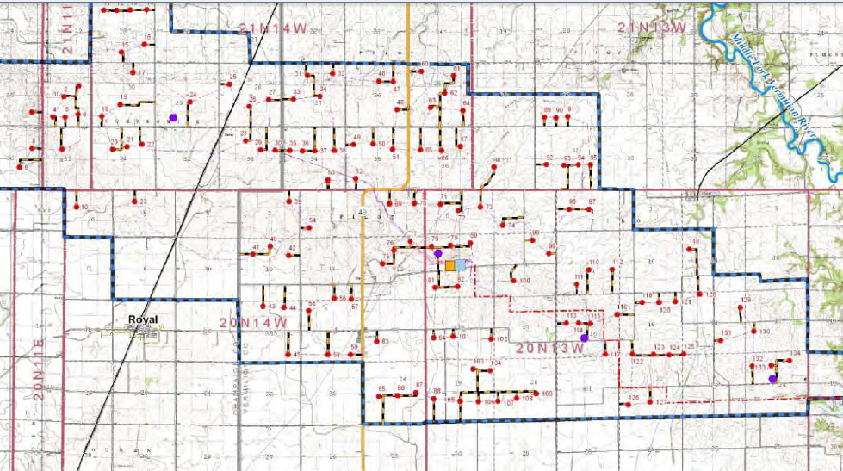
California Ridge Turbine Placement
Ogden and I74 are immediately south of edge of map
Source: http://www.co.vermilion.il.us/ctybrd/Vermilion%20County%20-%20California%20Ridge%20wind%20project%20building%20permit%20application.pdf

Slide 33
Time Variation of Wind
We need to not just consider how often the wind blows but also when it blows with respect to the electric load.
Wind patterns vary quite a bit with geography, with coastal and mountain regions having more steady winds.
In the Midwest the wind tends to blow the strongest when the electric load is the lowest.

Slide 34
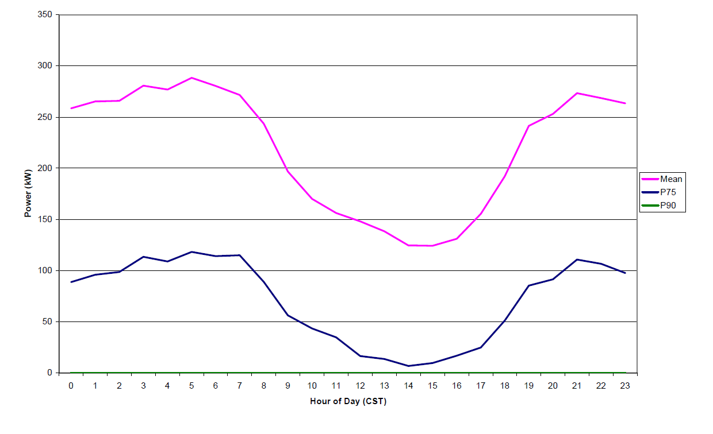
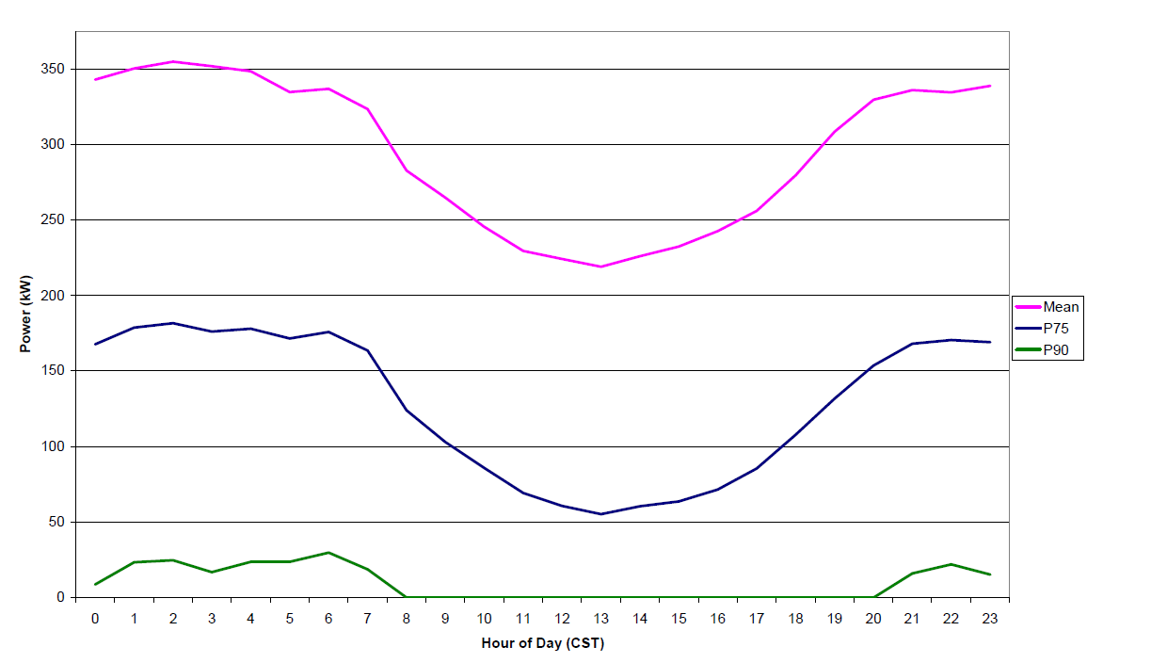
Upper Midwest Daily Wind Variation
August
April
Graphs show the mean, and then (going down) the 75% and 90% probability values; note for August the 90% probability is zero.
Source: www.uwig.org/XcelMNDOCwindcharacterization.pdf

Slide 35
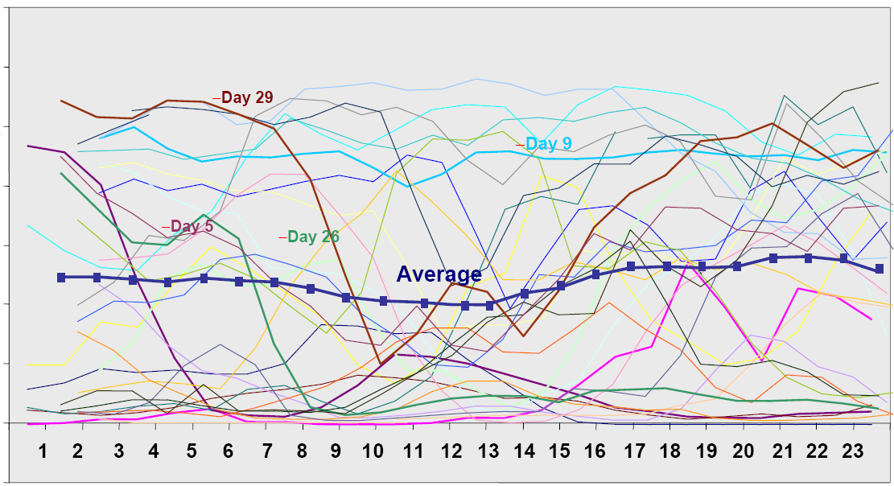
California ISO Daily Wind Energy
700
600
500
400
300
200
100
0
hour

Slide 36
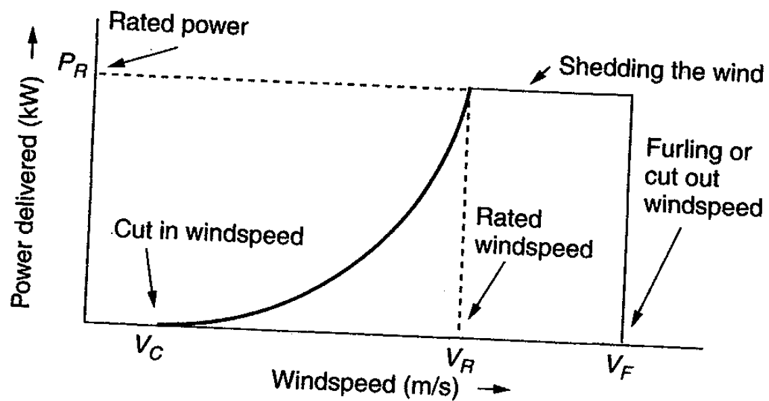
Idealized Power Curve
Figure 7.19
Cut –in windspeed, rated windspeed, cut-out windspeed

Slide 37
Idealized Power Curve
Before the cut-in windspeed, no net power is generated
Then, power rises like the cube of windspeed
After the rated windspeed is reached, the wind turbine operates at rated power (sheds excess wind)
Three common approaches to shed excess wind
  Pitch control – physically adjust blade pitch to reduce angle of attack
  Stall control (passive) – blades are designed to automatically reduce efficiency in high winds
  Active stall control – physically adjust blade pitch to create stall

Slide 38
Idealized Power Curve
Above cut-out or furling windspeed, the wind is too strong to operate the turbine safely, machine is shut down, output power is zero
“Furling” –refers to folding up the sails when winds are too strong in sailing
Rotor can be stopped by rotating the blades to purposely create a stall
Once the rotor is stopped, a mechanical brake locks the rotor shaft in place

Slide 39
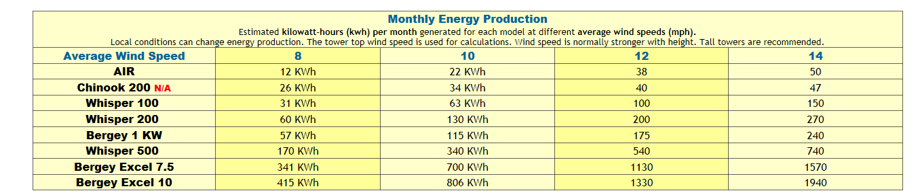
Current Prices for Small Wind
Kansas Wind Power-W is selling a 1000W (at 26 mph!) wind turbine for $3300; inverter (maybe $250), tower and batteries are extra (65’ tower goes for about $2100 plus installation) (Whisper 200; designed for 200 kWh per month in a 12 mph wind (about $20 per month)
Most Illinois sites are < 12 mph at 65’
http://www.kansaswindpower.net/Wind%20Generators%20-%20Whisper.htm

Slide 40
Small Wind Turbine Cost
Assume total cost is $5000
  Federal credit reduces cost to $3500
With an assumed lifetime of 15 years and simple payback (no interest), the annual cost is $233.
Say unit produces 200 kWh per month, or 2400 kWh per year.
This unit makes economic sense if electricity prices are at or above 233/2400 = $0.097/kWh.
With modest annual O&M, say $50, this changes to $0.118/kWh.
Notes:
39

Slide 41
Economies of Scale
Presently large wind farms produce electricity more economically than small operations
Factors that contribute to lower costs are
  Wind power is proportional to the area covered by the blade (square of diameter) while tower costs vary with a value less than the square of the diameter
  Larger blades are higher, permitting access to faster winds
  Fixed costs associated with construction (permitting, management) are spread over more MWs of capacity
  Efficiencies in managing larger wind farms typically result in lower O&M costs (on-site staff reduces travel costs)
Notes:
40

